Slide 1
Bio& 241 A&P
Unit 4 Lecture 2

Slide 2
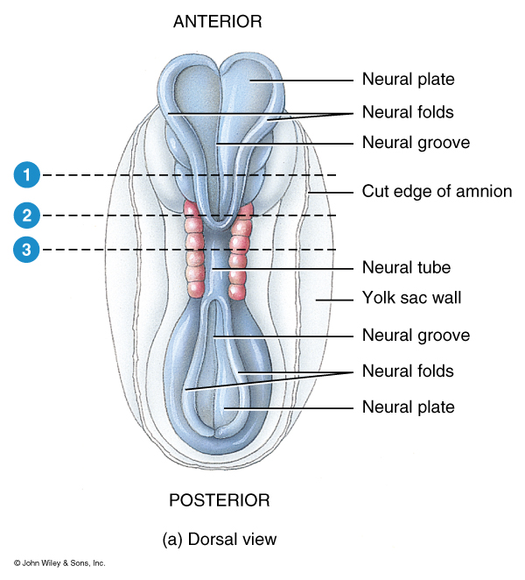
Embryonic Development of the Brain and Spinal Cord

Slide 3
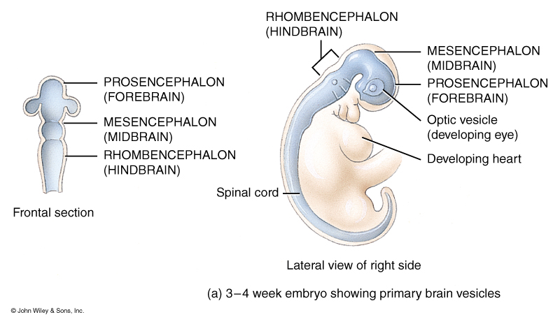
Embryonic Development of the Brain and Spinal Cord, Primary Structures

Slide 4
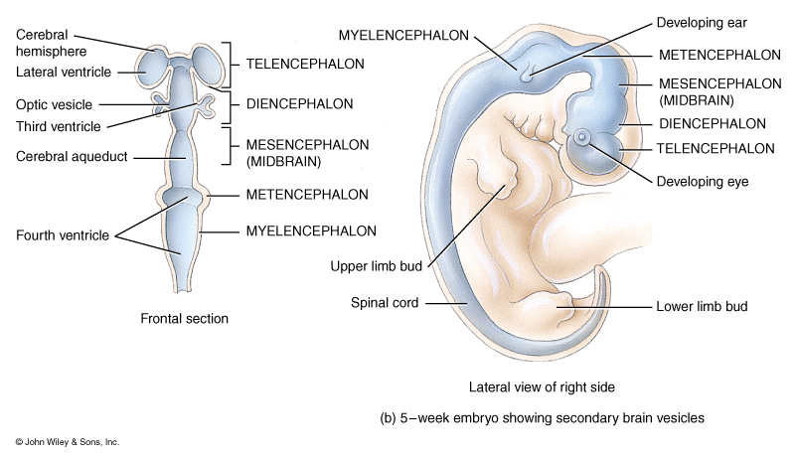
Embryonic Development of the Brain and Spinal Cord, Secondary Structures

Slide 5
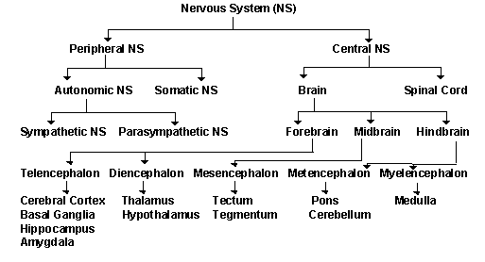
Flow Chart for the Nervous System

Slide 6
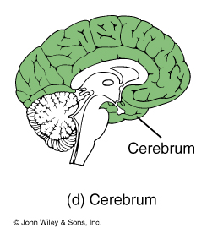
Major Structures of the Brain

Slide 7
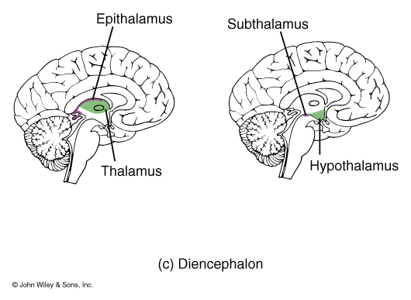
Major Structures of the Brain

Slide 8
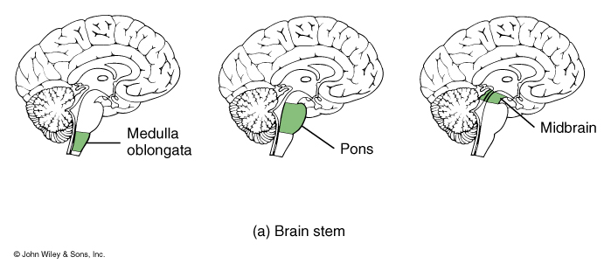
Major Structures of the Brain

Slide 9
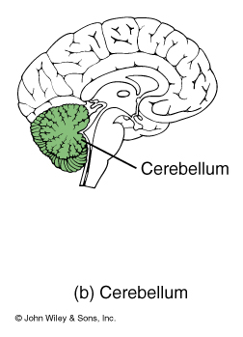
Major Structures of the Brain

Slide 10
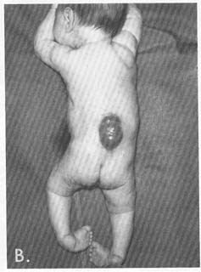
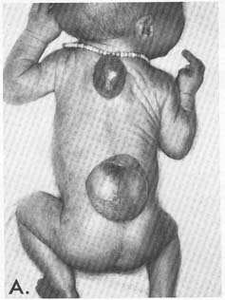
Embryonic Development of the Brain and Spinal Cord

Slide 11
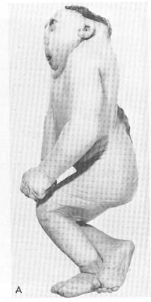
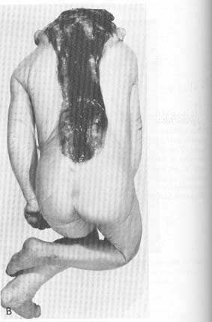
Embryonic Development of the Brain and Spinal Cord

Slide 12
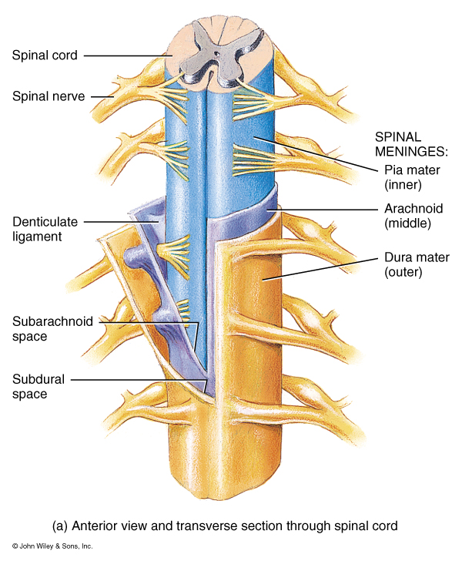
Arrangement of the Meninges and their spaces

Slide 13
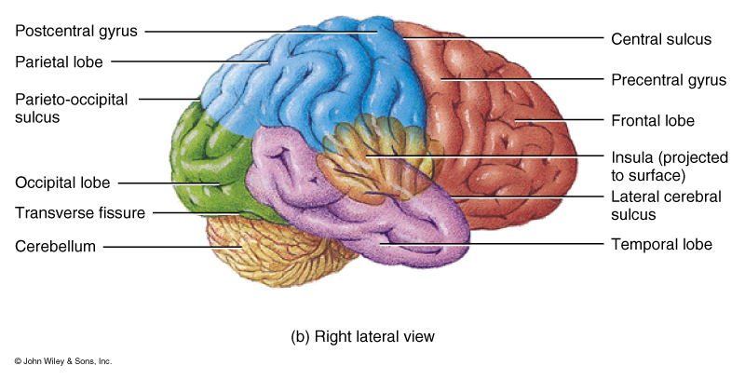
Lobes of the Cerebral Cortex

Slide 14
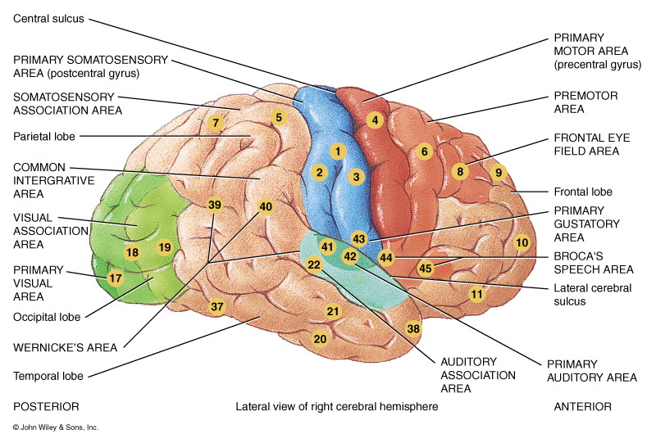
Functional Areas of the Cerebral Cortex

Slide 15
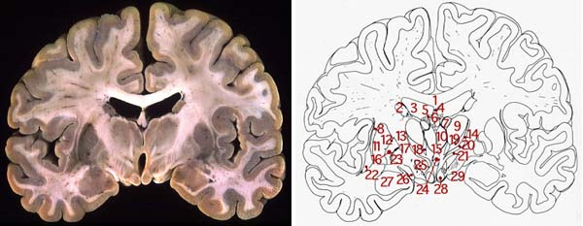
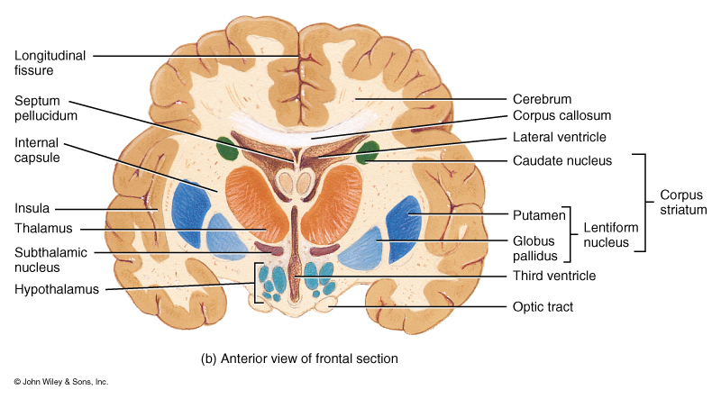
Major Structures of the Brain as seen in Frontal Section

Slide 16
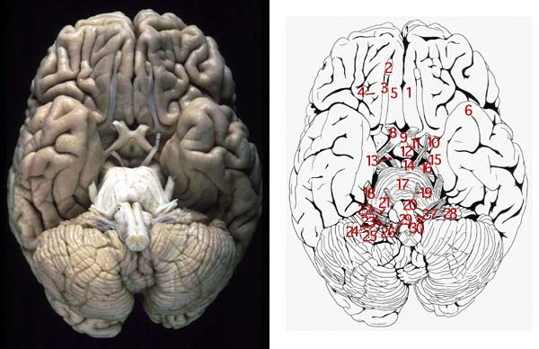
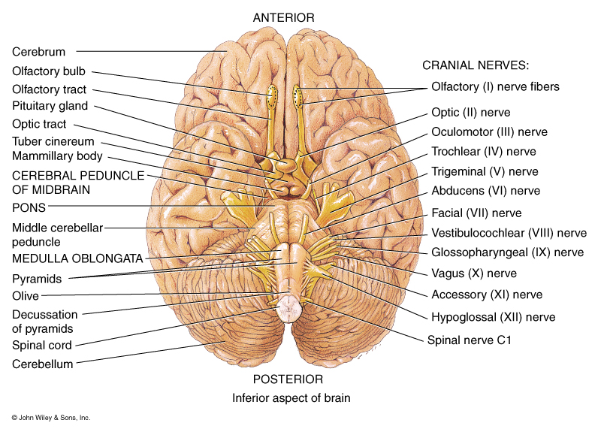
Major Structures of the Brain as seen from an inferior view including cranial nerves

Slide 17
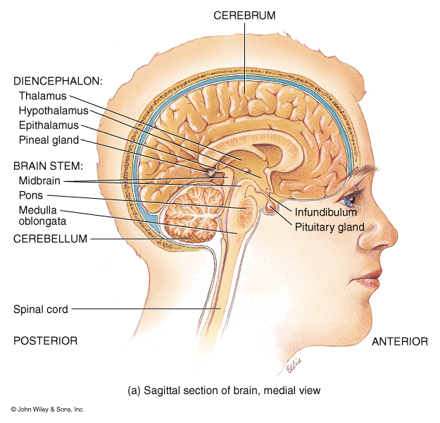
Major Structures of the Brain as seen in midsagittal
Septum pellucidum
Corpus Callosum

Slide 18
Major Structures of the Brain
Fornix
Intermediate mass of
the Thalamus

Slide 19
Major Structures of the Brain
Cisterna superiors
Corpora Quadrigemina
Cisterna cerebello
medullaris

Slide 20
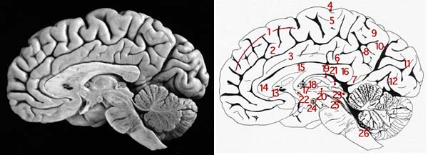
Major Structures of the Brain

Slide 21
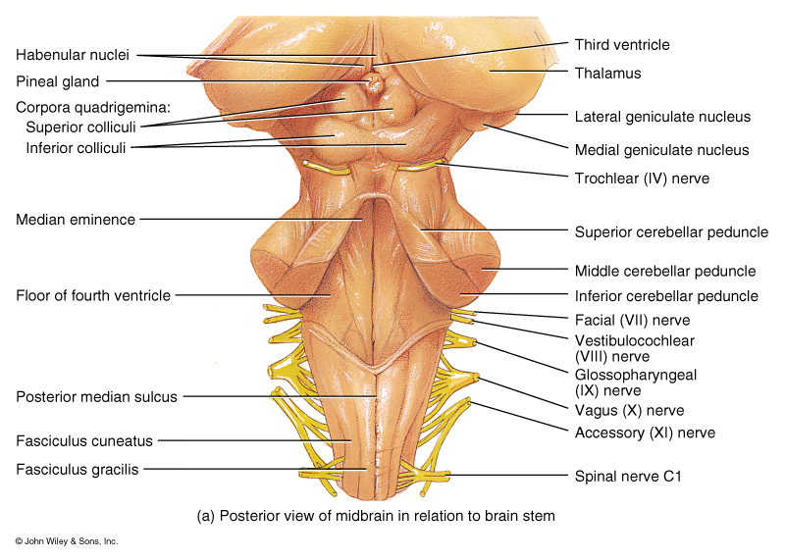
Major Structures of the Brain

Slide 22
Cerebrospinal Fluid “CSF”
Blood-Brain Barrier: formed by tight junction of the endothelial
cells of capillaries, tight junction between
ependymal cells and astrocytes. These three tissues
are involved in production of CSF.
Total Volume: 80-150 ml
Production rate: 20ml/hr.
Composition: glucose, proteins, lactic acid, urea
cations (Na+, K+, Ca2+, Mg2+)
anions (Cl-, HCO3-)
Functions:
1. Mechanical protection
2. Chemical protection
hyponatremia, hypernatremia
3. Circulation

Slide 23
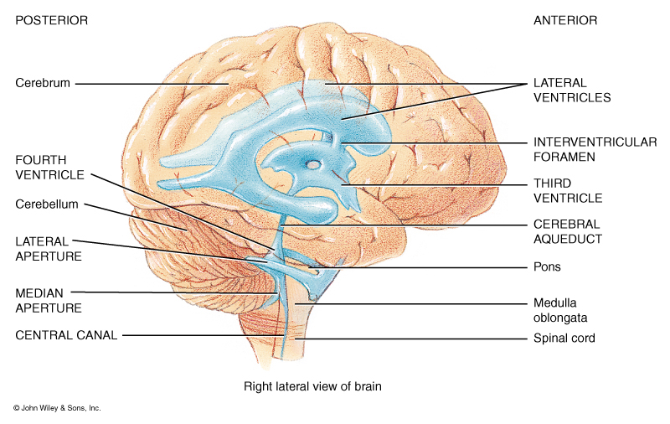
Ventricles of the Brain

Slide 24
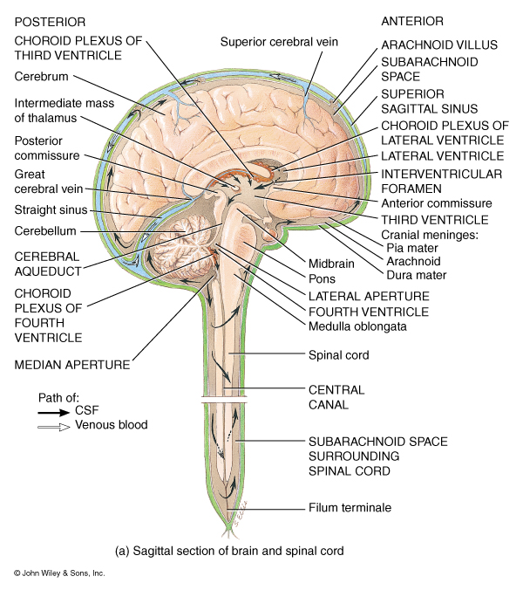
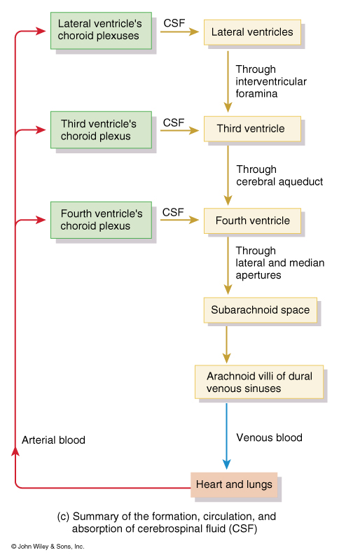

Slide 25
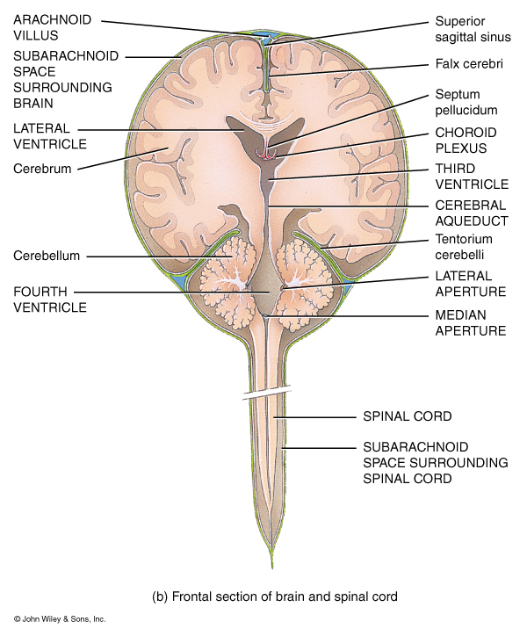

Slide 26
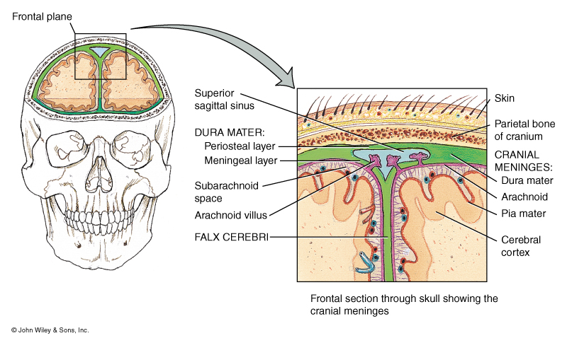

Slide 27
